Slide 1
SMARTQUIZZER
Team 2

Slide 2
Introduction
Smart Quizzer is an AI-based quiz application designed to provide personalized assessments.
It adapts quiz difficulty according to user performance, ensuring an effective learning experience.
The system generates multiple-choice questions (MCQs) dynamically from educational material.
Provides a secure and interactive platform for learners with role-based access.

Slide 3
project overview
User features :
. Register & login securely.
. Select topic, subtopic, difficulty.
. Choose number of questions (5/10/20).
. Attempt quizzes with multiple-choice questions.
. Submit quiz → see results instantly.
. Past quiz attempts stored in dashboard.
. Receive personalized difficulty AI recommendations based on performance.

Slide 4
project overview
Admin features :
Secure login for admin.
Upload study materials (PDFs).
Upload MCQ PDFs → system extracts & stores in database automatically.
Manage topics , subtopics and difficulty levels

Slide 5
Milestone 1
Implemented features:
Home Page with navigation.
Login & Registration functionality.
Database connection for storing user registration details securely.
Future milestones will add adaptive quiz generation and admin dashboard.

Slide 6
Milestone 2
Implemented features:
Developed admin dashboard and user dashboard.
Implement file upload (pdf → extract mcq’s) functionality.
Store mcq’s (topic, subtopic, difficulty, options, correct answer) in the database.
Ensure admin can view, edit, and manage study materials.

Slide 7
Milestone 3
Implemented features:
Added a new quiz history section in the user dashboard
Displayed topic, subtopic, difficulty, quizzes taken, and average score.
Updated quiz submission flow to store results and update history automatically.
Improved dashboard ui with a history table for better progress tracking.

Slide 8
Milestone 4
Implemented features:
. Added an ai-powered suggestion system on the user dashboard.
. Suggested the next difficulty level based on the user’s average scores
Easy → medium (≥5 tests, avg ≥80%)
Medium → hard (≥5 tests, avg ≥75%)
Hard → next topic (≥3 tests, avg ≥80%)
. Personalized learning recommendations to encourage progression.
. Integrated suggestions into the dashboard ui for immediate visibility.

Slide 9
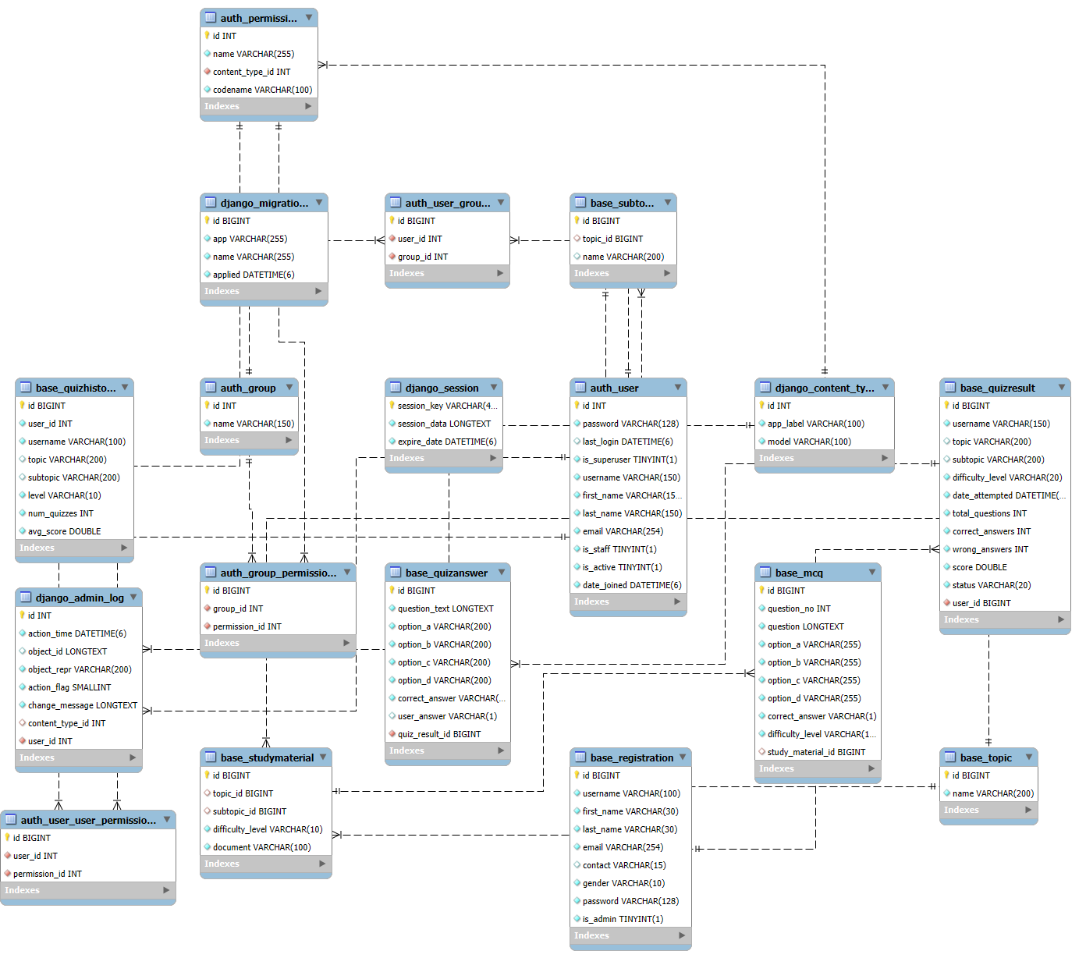
DATABASE:

Slide 10
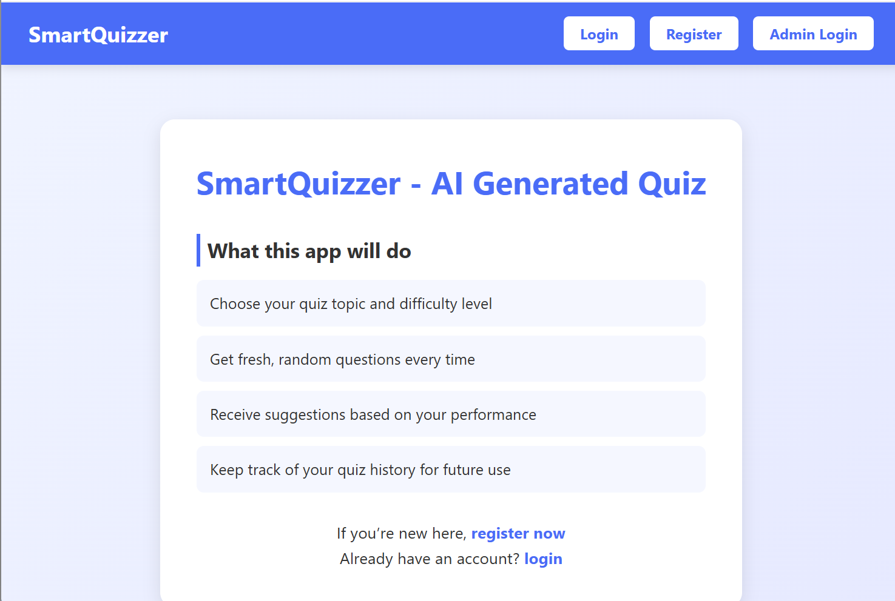
HOME PAGE:

Slide 11
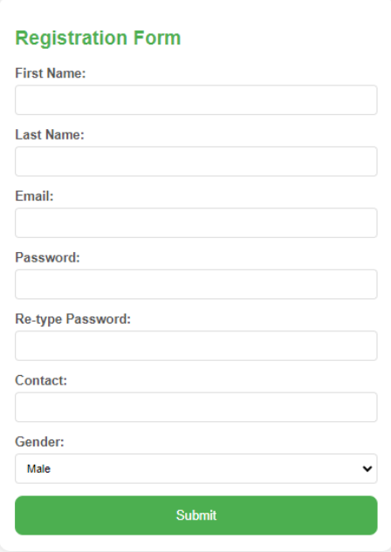
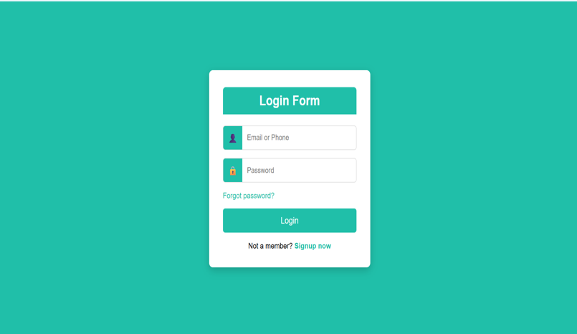
Register & Login of users:

Slide 12
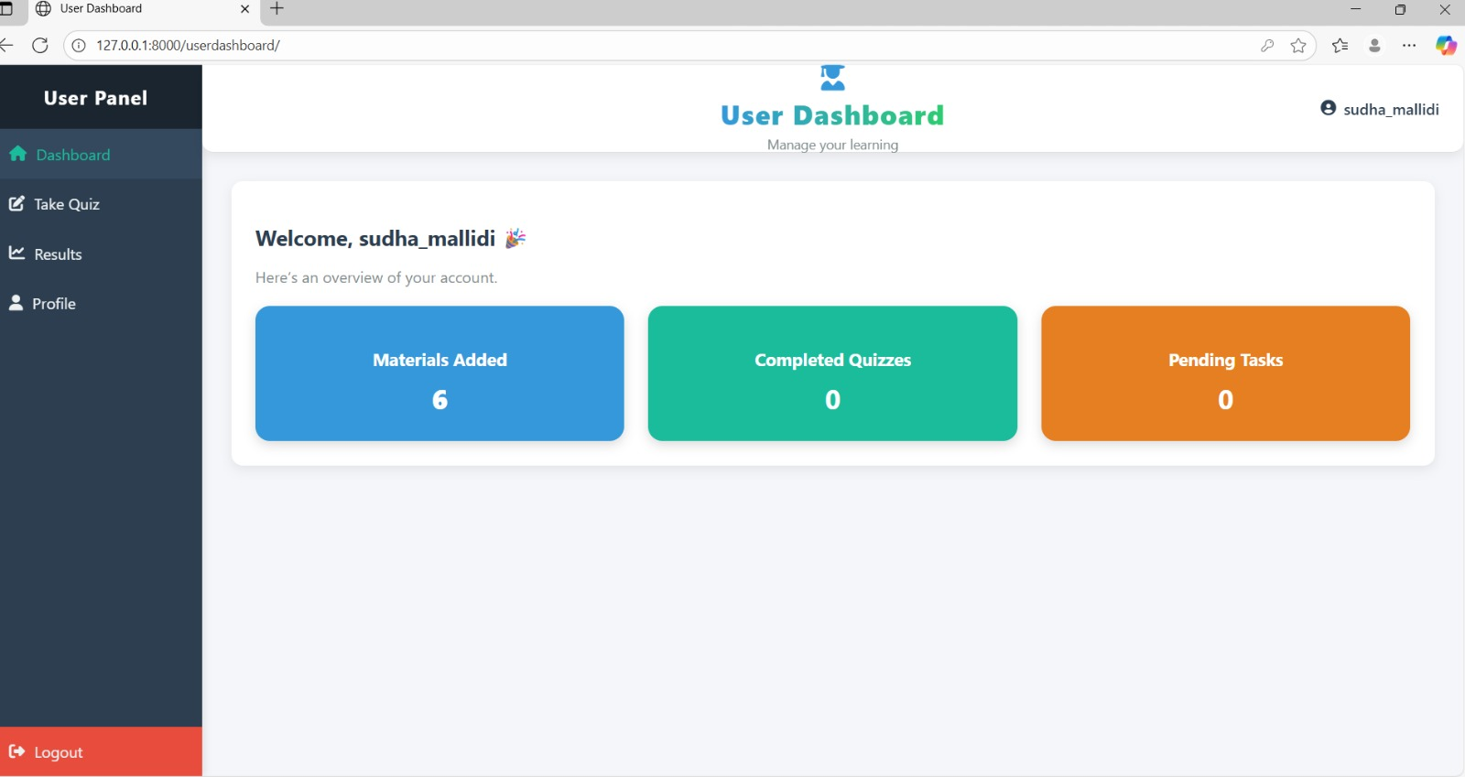
User dashboard

Slide 13
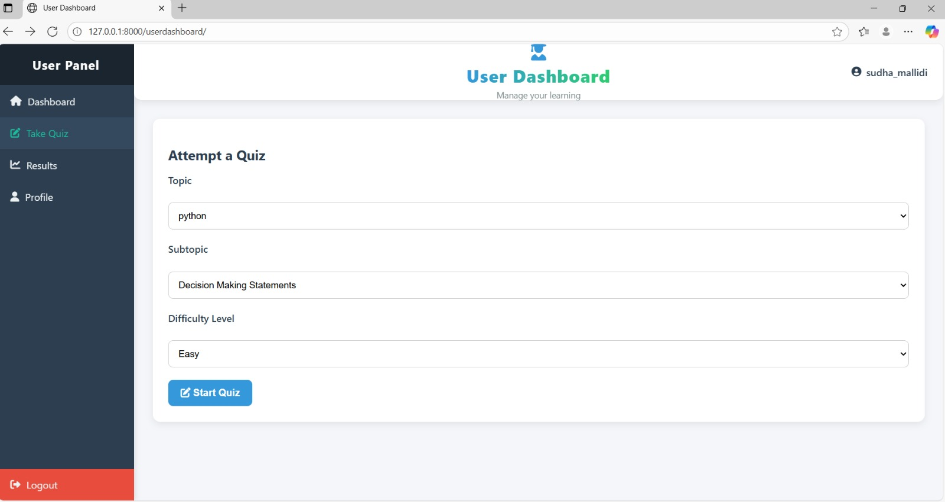
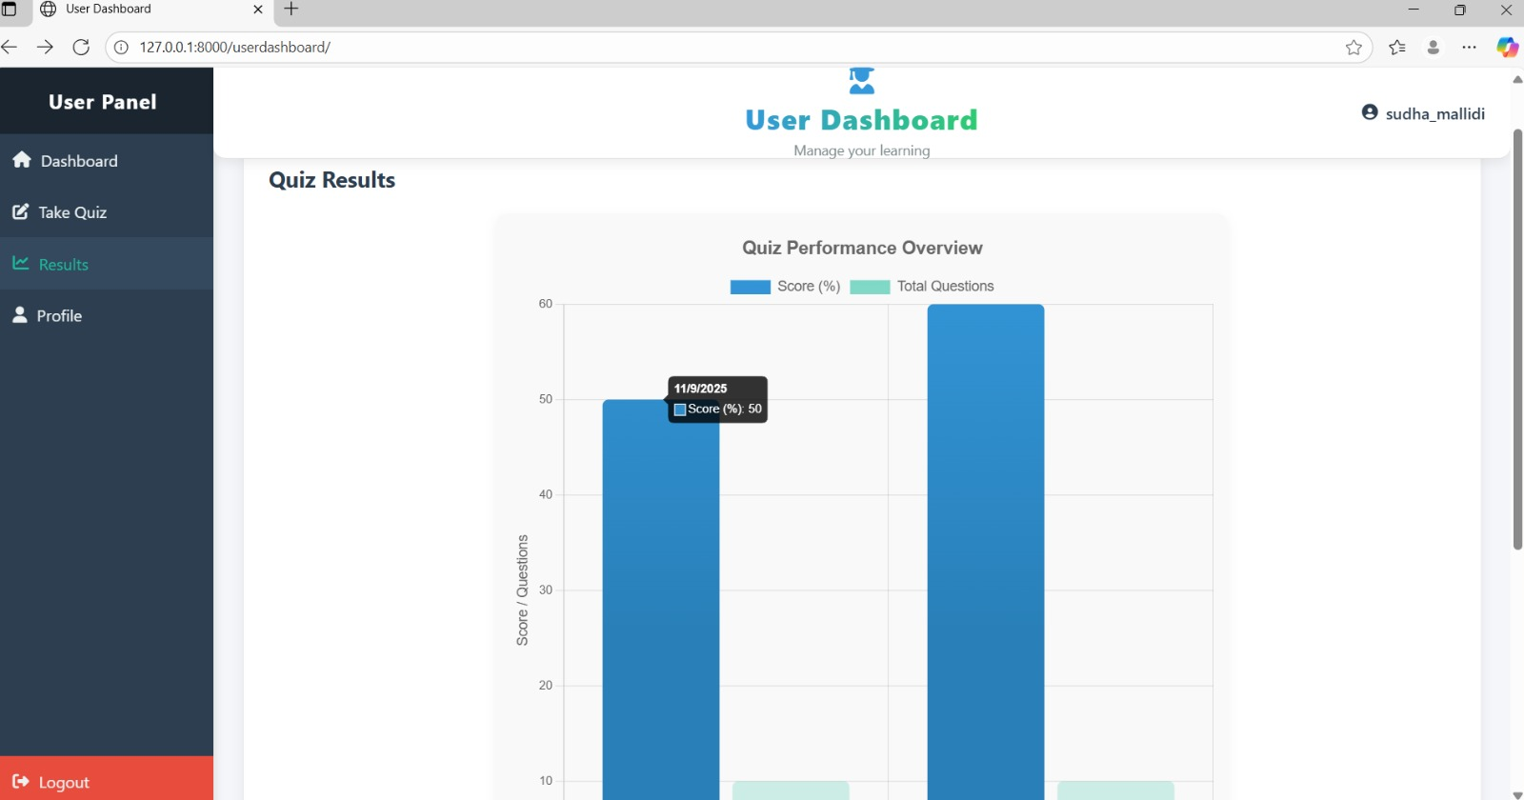
User Dashboard(quiz & result)

Slide 14
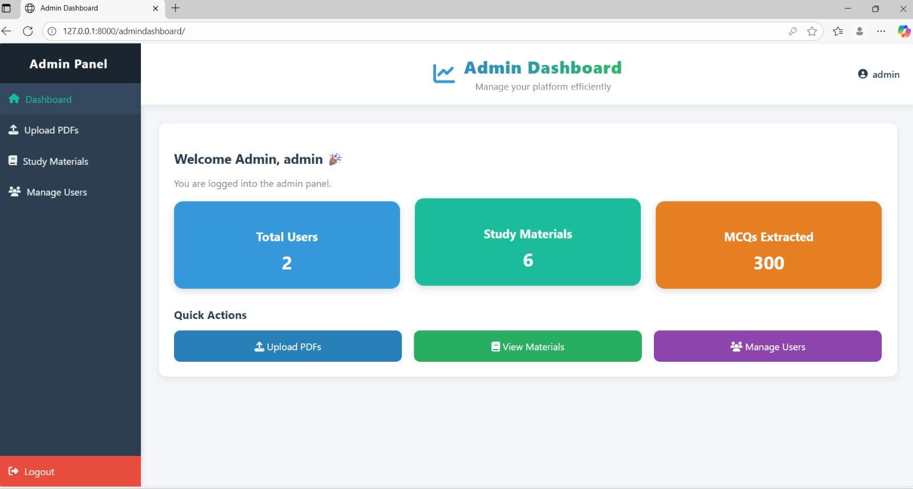
Admin dashboard

Slide 15
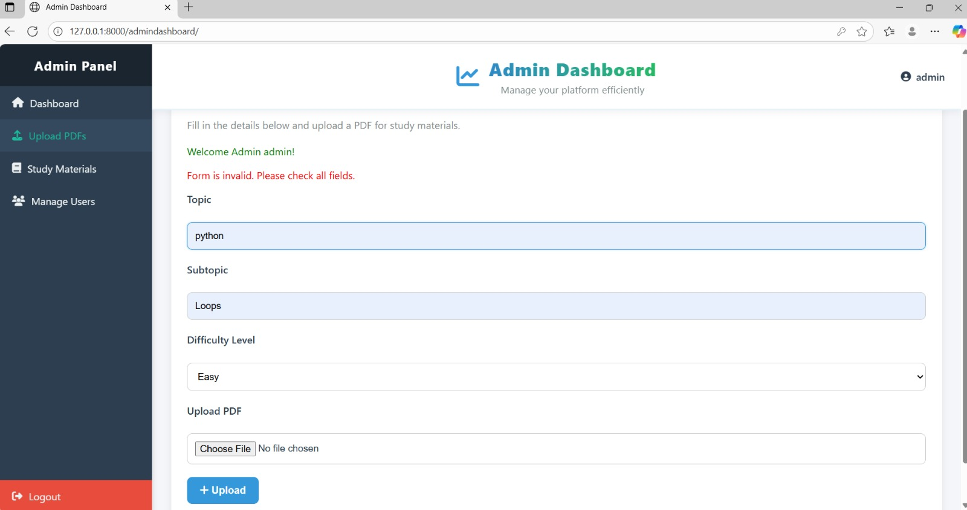
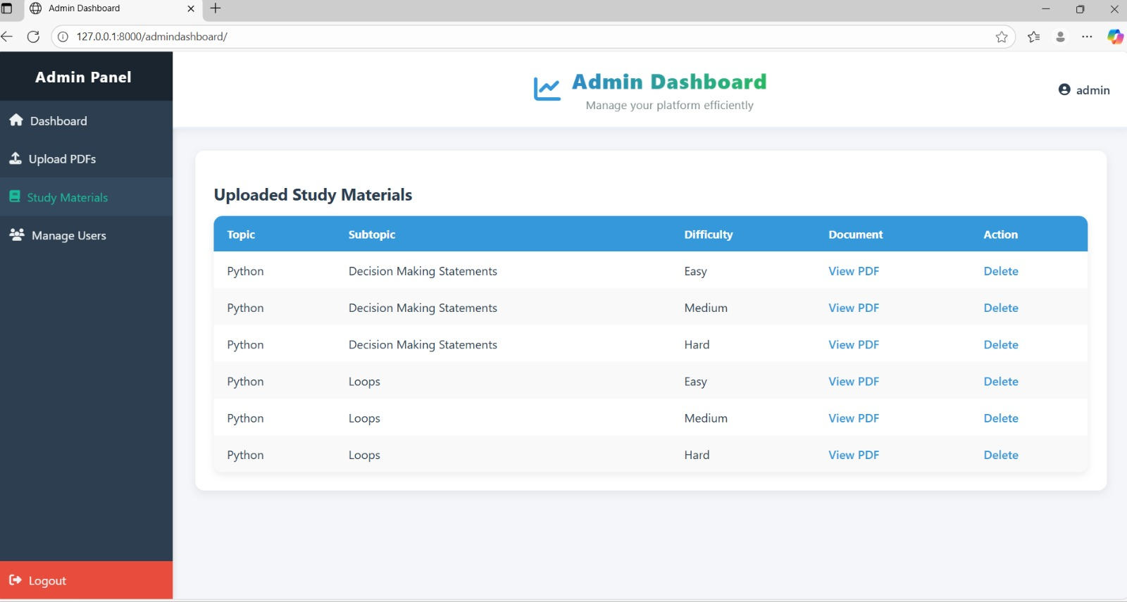
Admin dashboard(upload pdf , study materials)

Slide 16
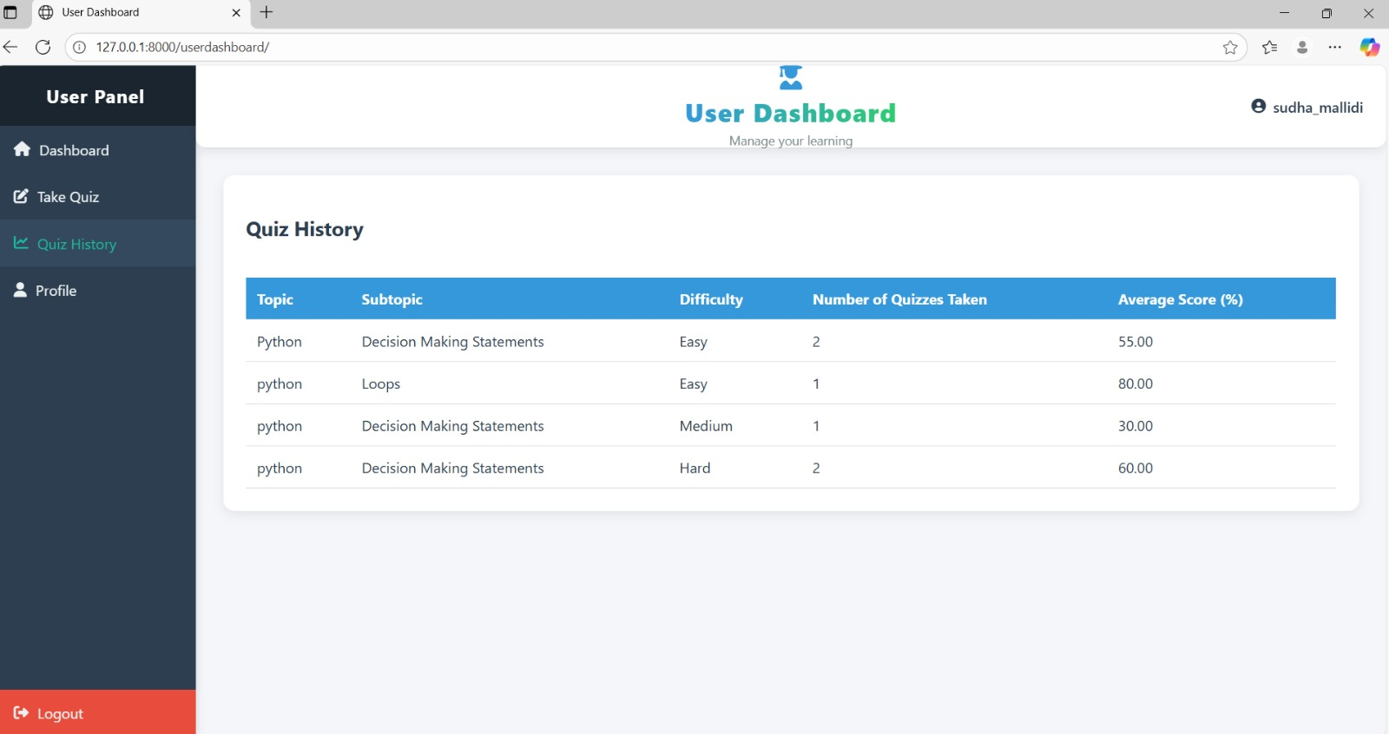
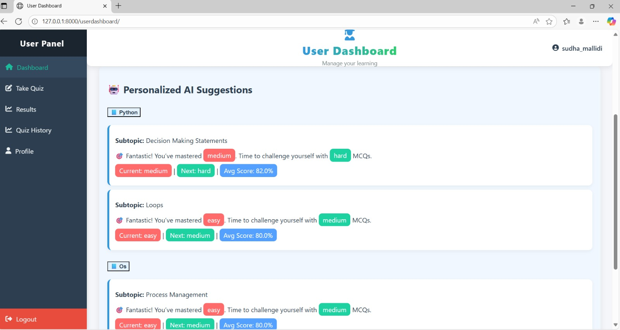
Quiz history & AI SUGGESTIONS

Slide 17
conclusion
Smart quizzer is a robust and innovative ai-powered quiz platform that transforms the learning experience through personalization, automation, and adaptability. By integrating secure access, intelligent quiz generation, progress tracking, and ai-based recommendations, it empowers learners to advance at their own pace while giving administrators efficient content management tools. This project demonstrates how technology can bridge gaps in education, offering a scalable and future-ready solution that enhances engagement, performance, and continuous learning.

Slide 18
TEAM MEMBERS
J Bhavya
J Meghana
M Mohana Sudha

Slide 19
Thank You

